Slide 1
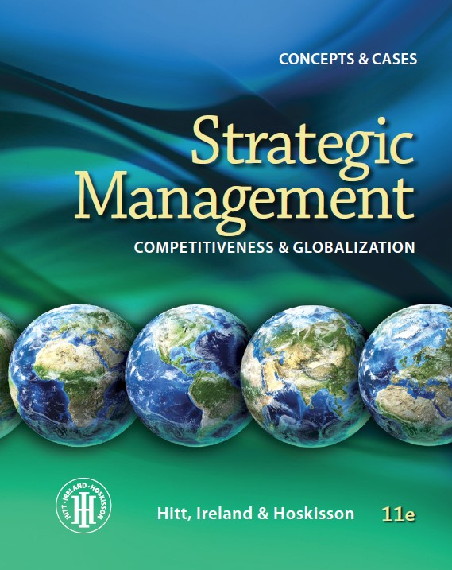
Chapter 1
Strategic Management and Strategic Competitiveness
PART 1 STRATEGIC MANAGEMENT INPUTS
Presentation design by Charlie Cook

Slide 2
Learning Objectives
Studying this chapter should provide you with the strategic management knowledge needed to:
Define strategic competitiveness, strategy, competitive advantage, above-average returns, and the strategic management process.
Describe the competitive landscape and explain how globalization and technological changes shape it.
Use the industrial organization (I/O) model to explain how firms can earn above-average returns.
Use the resource-based model to explain how firms can earn above-average returns.
Describe vision and mission and discuss their value.
Define stakeholders and describe their ability to influence organizations.
Describe the work of strategic leaders.
Explain the strategic management process.

Slide 3
Twenty-First Century Competition
Today’s Competitive Markets
The global economy
Rapid technological change
Increasing importance of knowledge and people
Globalization

Slide 4
Strategic Competitiveness
Formulation and implementation of a superior value-creating strategy
Commitments and actions to achieve above-average performance and returns
What the firm will do
Competitive advantage
What the firm will not do

Slide 5
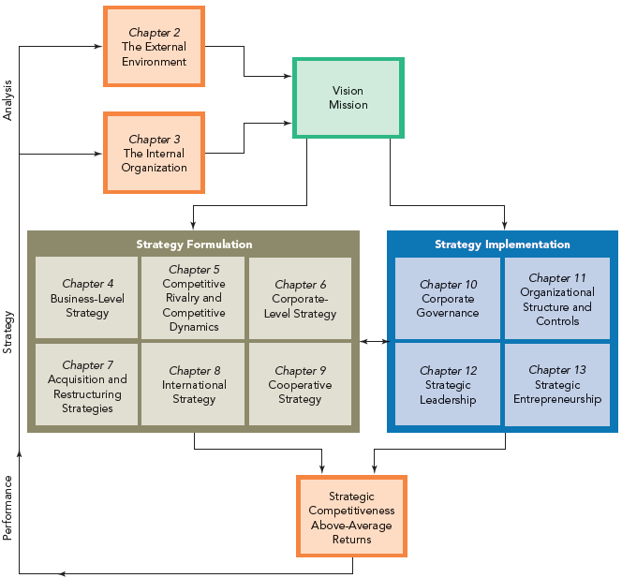
Figure 1.1 The Strategic Management Process

Slide 6
The Global Competitive Landscape
Increasing
Market volatility and instability due to the rapid pace of change in markets
Blurring of market boundaries
Globalized flow of financial capital
Need for flexibility, speed, innovation, and integration in the use of technology
Strategic and operational complexity of global-scale competition
Rising product quality standards
Decreasing
Traditional time for adapting to change
Traditional sources of competitive advantage
Traditional managerial mindset

Slide 7
Hypercompetition
Strategic options in hypercompetitive environments
Global economy
Technology
Use of price-quality positioning to build market presence
Creation of new know-how and use of first-mover advantage
Protection or invasion of established geographic or product markets

Slide 8
Competitive Success Factors
Top Corporate Performers
Have an entrepreneurial/ opportunistic mindset
Make effective use of valuable competencies
Offer new and innovative products and services
Are market/ customer-needs oriented

Slide 9
Technology and Technological Changes
Increasing rate of technology diffusion and the emergence of disruptive technologies
Technology trends impacting the global competitive environment
The information age: Internet and the global proliferation of low-cost computing power
Increasing knowledge intensity as an intangible source of competitive advantage

Slide 10
Strategic Flexibility
Strategic Flexibility
involves coping with the uncertainty and risks of hypercompetitive environments.
must first overcome built-up organizational inertia.
requires developing the capacity for continuous learning and applying the new and updated skills sets and competencies to the firm’s competitive advantage.

Slide 11
The Industry Organization (I/O) Model of Above-Average Returns
The Firm’s Strategic Choices
Economies of scale
Barriers to market entry
Diversification
Product differentiation
Industry concentration
Market frictions

Slide 12
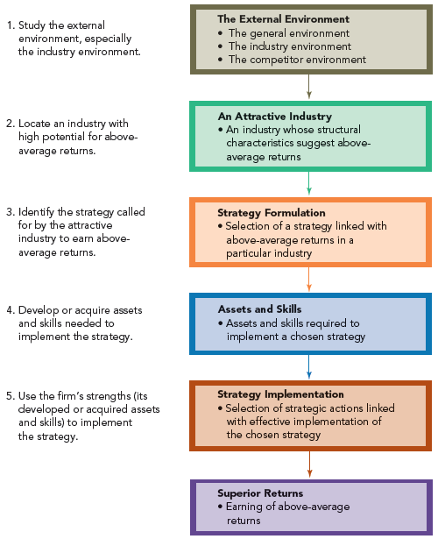
Figure 1.2 The I/O Model of Above-Average Returns

Slide 13
I/O Model Assumptions
The external environment imposes pressures and constraints that determine strategic choices.
Similarity in strategically relevant resources causes competitors to pursue similar strategies.
Resource differences among competitors are short-lived due to resource mobility across firms.
Strategic decision makers are rational and engage in profit-maximizing behaviors.

Slide 14
Five Forces Model of Competition
Substitutes
Suppliers
Industry Rivalry
Buyers
Potential Entrants

Slide 15
Five Forces Model Assumptions
Industry profitability (i.e., rate of return on invested capital relative to cost of capital) is a function of interactions among the five forces.
Industry attractiveness equates to its profitability potential for earning above-average returns by:
Producing standardized goods or services at costs below competitor costs (a cost leadership strategy).
Producing differentiated goods or services for which customers are willing to pay a price premium (a differentiation strategy).

Slide 16
The Resource-Based Model of Above-Average Returns
Building competitive advantage
Core competence A source of competitive advantage
Capability
An integrated set of resources
Resources
Physical, human, and organizational capital (tangible and intangible)

Slide 17
Resource-Based Model Assumptions
Firms acquire different resources.
Firms develop unique capabilities based on how they combine and use resources.
Resources and certain capabilities are not highly mobile across firms.
Differences in resources and capabilities are the bases of competitive advantage and a firm’s performance rather than its industry’s structural characteristics.

Slide 18
Resources As Core Competencies
Costly to imitate
How resources become core competencies
Rare
Valuable
Nonsubstitutable

Slide 19
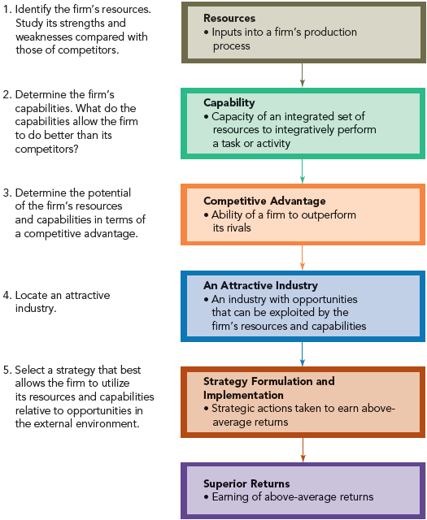
Figure 1.3 The Resource-Based Model of Above-Average Returns

Slide 20
Strategic Decision Making
Industry Organization (I/O) Model
Resource-Based Model
Competitive Strategy Decision

Slide 21
Vision Statement
A Successful Vision
is an enduring word picture of what the firm wants to be and expects to achieve in the future.
stretches and challenges its people.
reflects the firm’s values and aspirations.
is most effective when its development includes all stakeholders.
recognizes the firm’s internal and external competitive environments.
is supported by upper management decisions and actions.

Slide 22
Mission Statement
An Effective Mission
specifies the present business or businesses in which the firm intends to compete and customers it intends to serve.
has a more concrete, near-term focus on current product markets and customers than the firm’s vision.
should be inspiring and relevant to all stakeholders.

Slide 23
Stakeholders
Can affect development of the firm’s vision and mission
Primary stakeholders
(individuals, groups, and organizations)
Are affected by the strategic outcomes achieved by the firm
Can have enforceable claims on the firm’s performance
Are influential when in control of critical or valued resources

Slide 24
Classification of Stakeholders
Categories of stakeholders
Capital Market Stakeholders
Product Market Stakeholders
Organizational Stakeholders

Slide 25
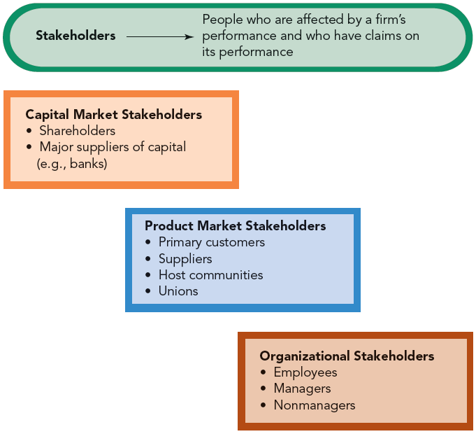
Figure 1.4 The Three Stakeholder Groups

Slide 26
Capital Market Stakeholders
Preservation of investment
Conflicting expectations of shareholders and lenders
Influence
Risk/return
Enhanced wealth

Slide 27
Product Market Stakeholders
Types of product market stakeholders
Suppliers
Customers
Host communities
Unions

Slide 28
Organizational Stakeholders
Responsibilities of strategic leaders for development and effective use of the firm’s human capital
Education and skills of employees
Organizational culture and ethical work environment
Strategic goals and global standards
International assignments

Slide 29
The Work of Effective Strategic Leaders
Strategic Leaders
have a strong strategic orientation that relies on thorough analysis when taking action.
are located at various levels throughout the firm.
want the firm and its people to accomplish more.
are innovative thinkers who promote innovation.
can leverage relationships with external parties while simultaneously promoting exploratory learning.
have an ambicultural (global mindset) approach to management.

Slide 30
Predicting Outcomes of Strategic Decisions: Profit Pools
Profit Pool
entails the total profits earned in an industry at all points along the value chain.
helps a firm see what others do not see and to understand primary sources of profits in an industry.
Identifying profit pools:
Define the pool’s boundaries
Estimate the pool’s overall size
Estimate the size of the pool’s value-chain activity
Reconcile the calculations

Slide 31
The Strategic Management Process: The ASP Process
Analyses
C2: The external environment
C3: The internal organization
Strategies
C4: Business-level strategies
C5: Marketplace competition
C6: Corporate-level strategies
Strategies (cont’d)
C7: Diversified portfolio management
C8: International strategies
C9: Cooperative strategies
Performance
C10: Governance mechanisms
C11: Organizational structure
C12: Strategic leadership
C13: Strategic entrepreneurship

